Slide 1


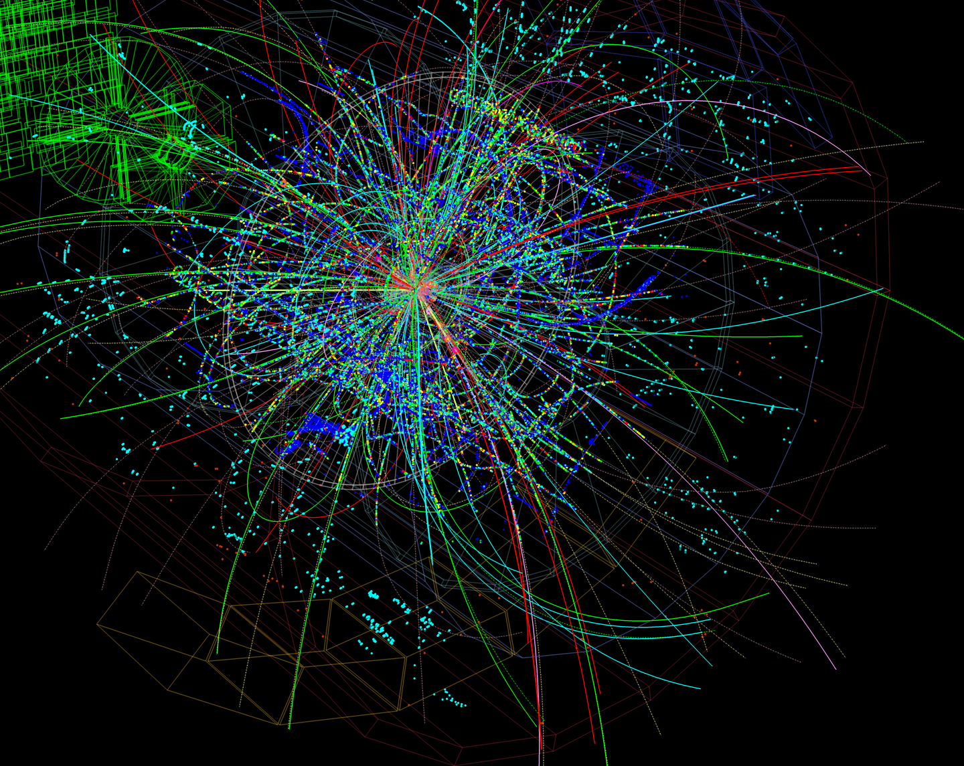
Numerical Simulations of Heavy Quark Exotica
Curtis Peterson, Richard Lebed, Jesse Giron

Slide 2
Chapter 1:
Heavy-quark bound states

Slide 3
Physics between 1947 and 1964
“The finder of a new elementary particles used to be rewarded by a Nobel prize, but such a discovery ought to be punished with a $10,000 fine.” - Willis Lamb, Nobel Laureate

Slide 4
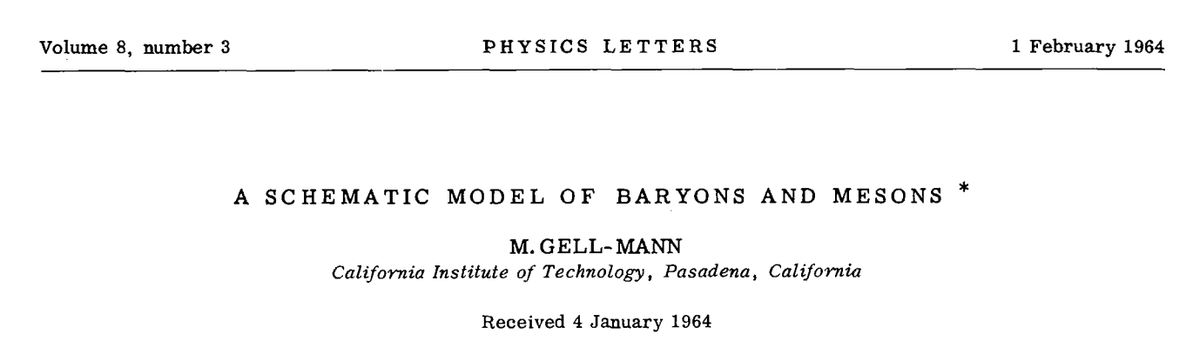
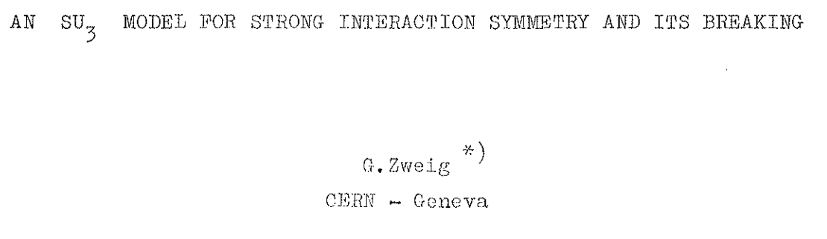
The quark model

Slide 5
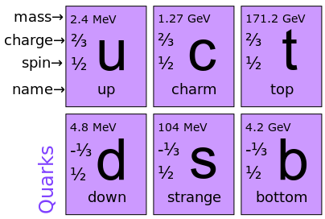
Standard model quarks
“Heavy” Quarks
“Light” Quarks

Slide 6
Quantum Chromodynamics (QCD)
“A non-Abelian, SU(3) gauge theory”
Interactions are mediated by eight fundamental particles called gluons
The gluons can interact with one another

Slide 7
The quark model does not allow quarks to be observed in isolation.

Slide 8
Instead, they form “QCD color-singlets” inside of particles called hadrons.
We call this phenomenon confinement.

Slide 9
Hadrons
The simplest color-singlet states are baryons and mesons.

Slide 10
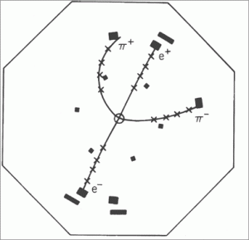
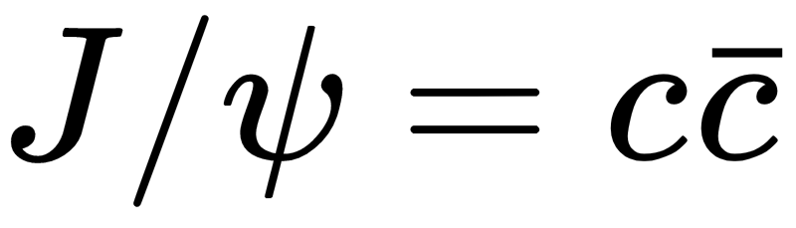
The November Revolution
Photo credit: SLAC/NOVA

Slide 11
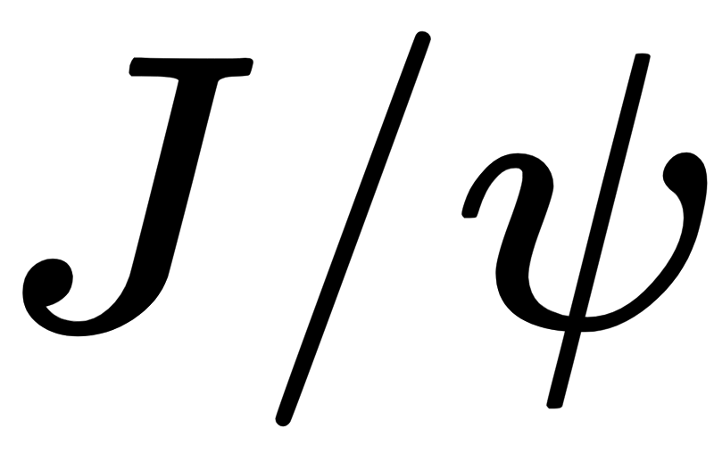


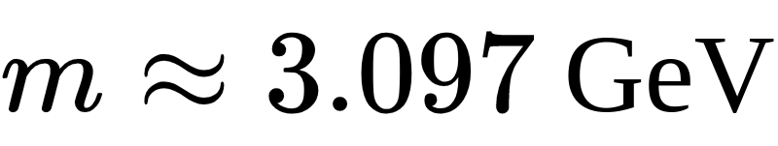
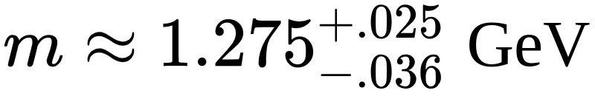
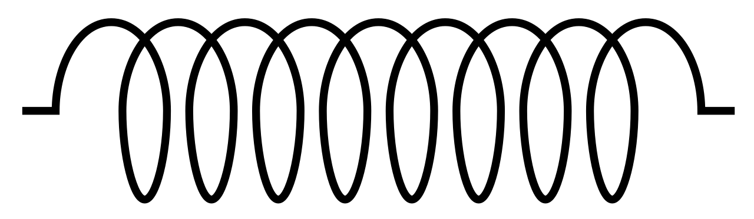

Charm Quark
The was the first heavy-quark bound state to be observed
anti-Charm Quark

Slide 12
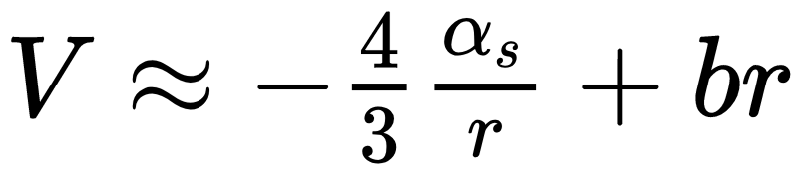
A first-order approximation to the full heavy-quark potential is:
This is called the Cornell potential.
It is degenerate in spin.

Slide 13
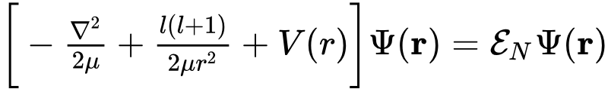
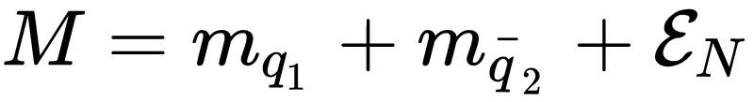
When we plug the Cornell potential into the Schroedinger equation and include spin-spin interactions, we obtain the mass spectra of heavy-quark bound states.

Slide 14
With inputs from experiment, this simple model predicts all of the lowest heavy-quark bound states.

Slide 15
Chapter 2:
The experimental status of exotics and their phenomenology

Slide 16
What is an exotic?

Slide 17
What is an exotic?
Any hadron that does not fit the standard quark model picture.
It can be a meson with “exotic” quantum numbers
It does not fit the quarkonium picture (it is not predicted by the Cornell potential)

Slide 18
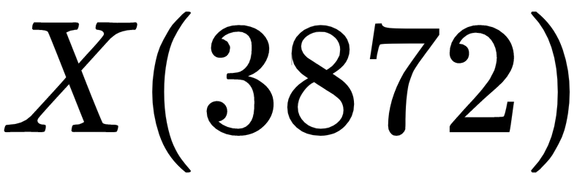
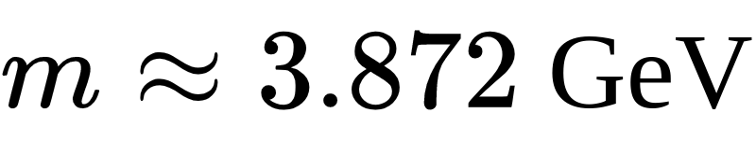
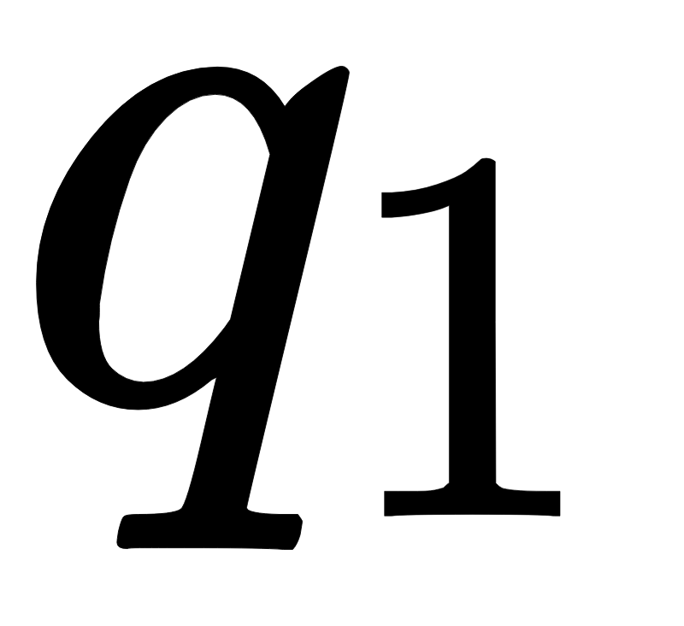
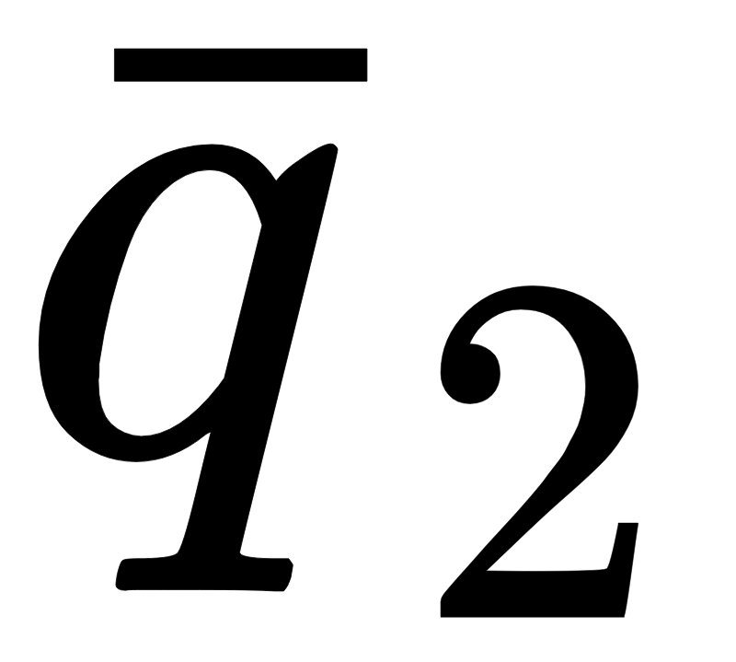
was the first exotic hadron to be observed
(2003 Belle Collaboration)

Slide 19
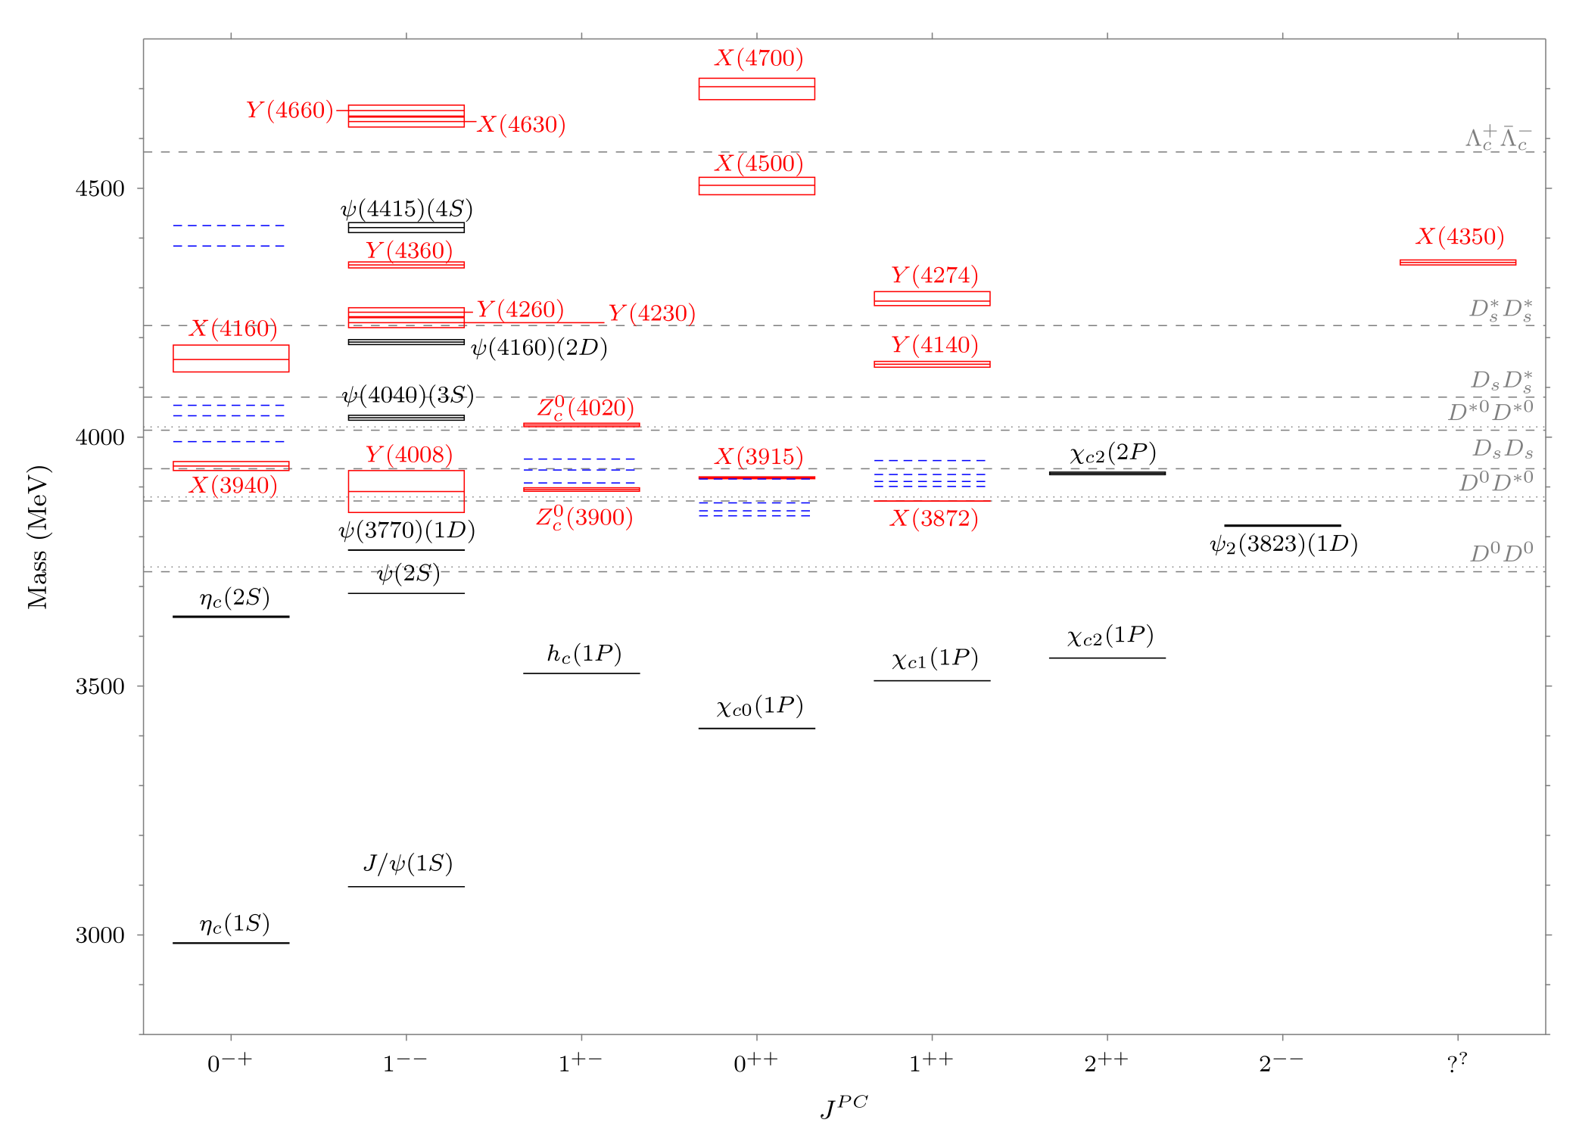
Since 2003, there have been 30+ observed exotic candidates.
Quarkonium hadrons are indicated by black lines.
Exotic candidates are indicated by red lines.
R. F. Lebed, R. E. Mitchell, and E. S. Swanson. Heavy-quark QCD exotica. Progress in Particle and Nuclear Physics,
93:143–194, 2017

Slide 20
Despite hot experimental activity, no theoretical model has been capable of reproducing a significant sector of the observed spectrum.

Slide 21
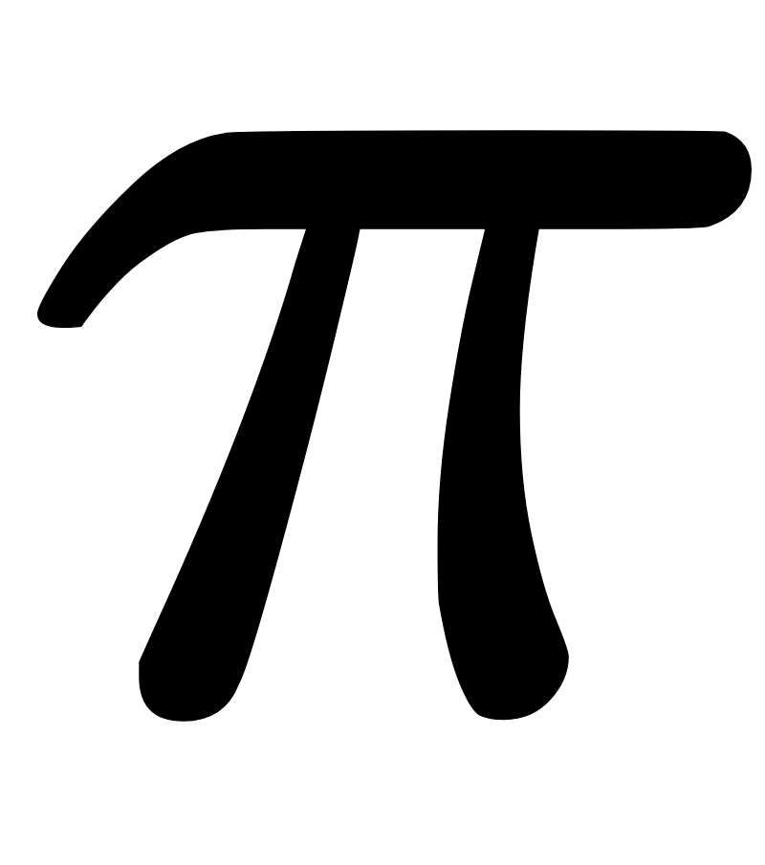
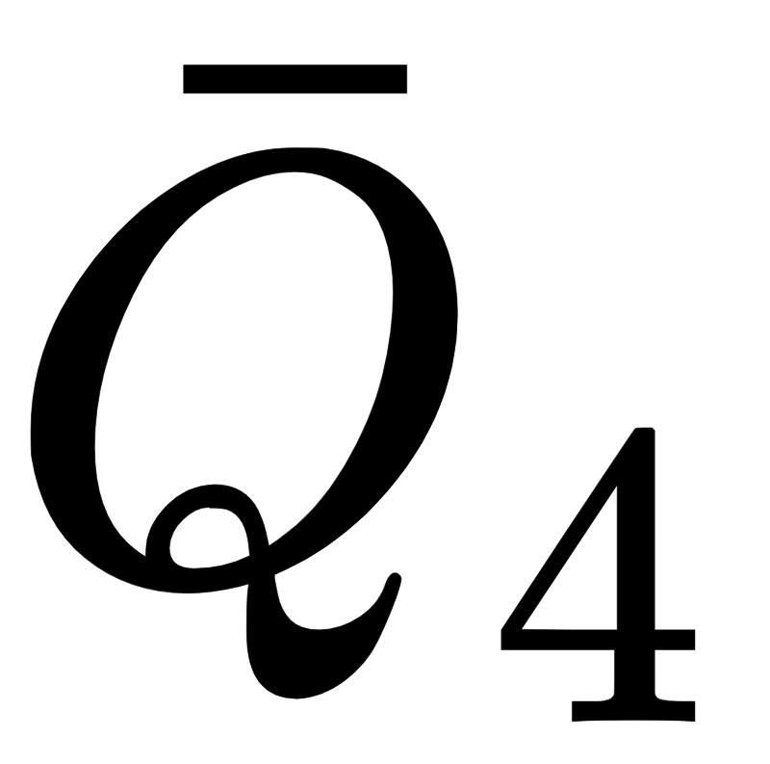
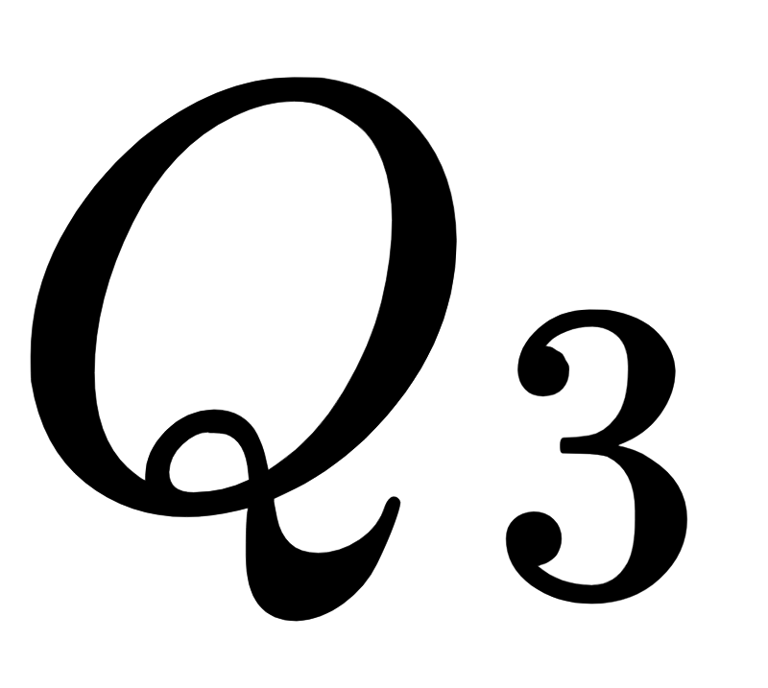
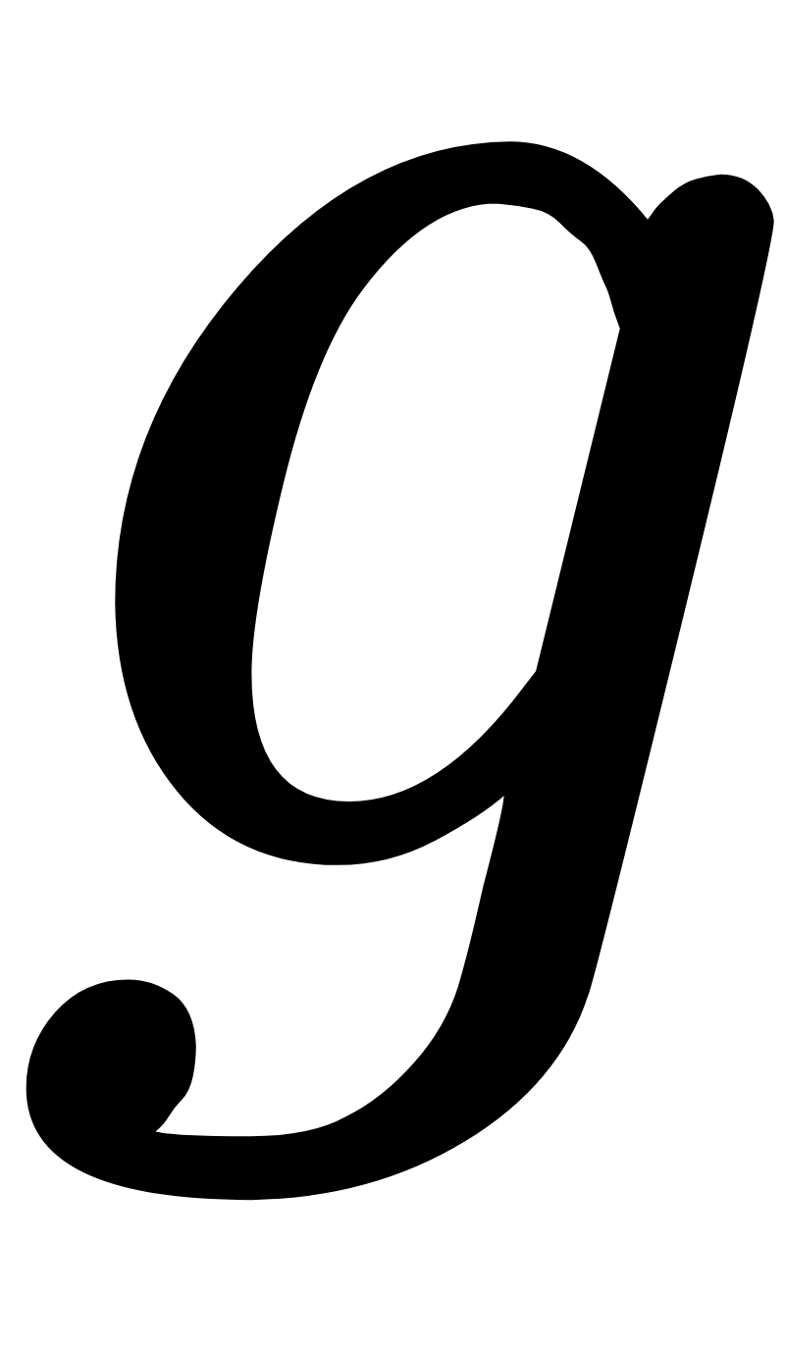
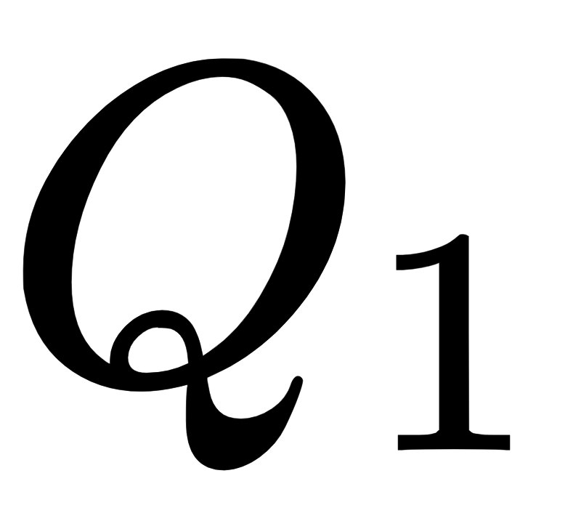
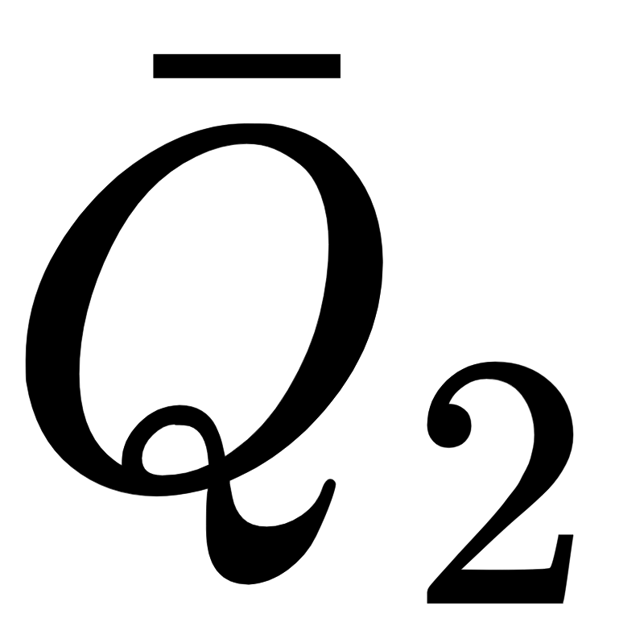

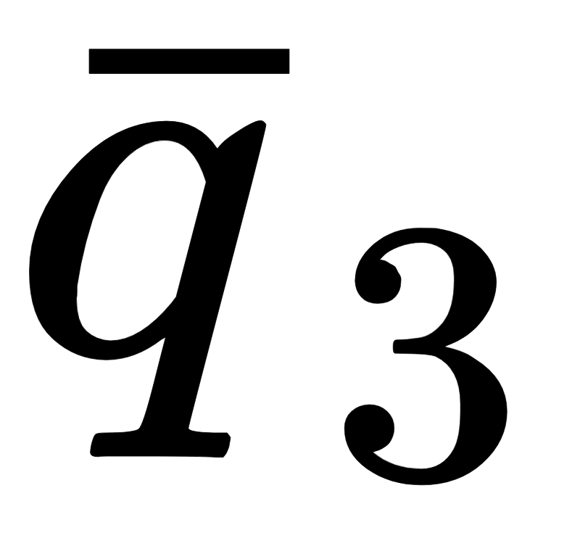
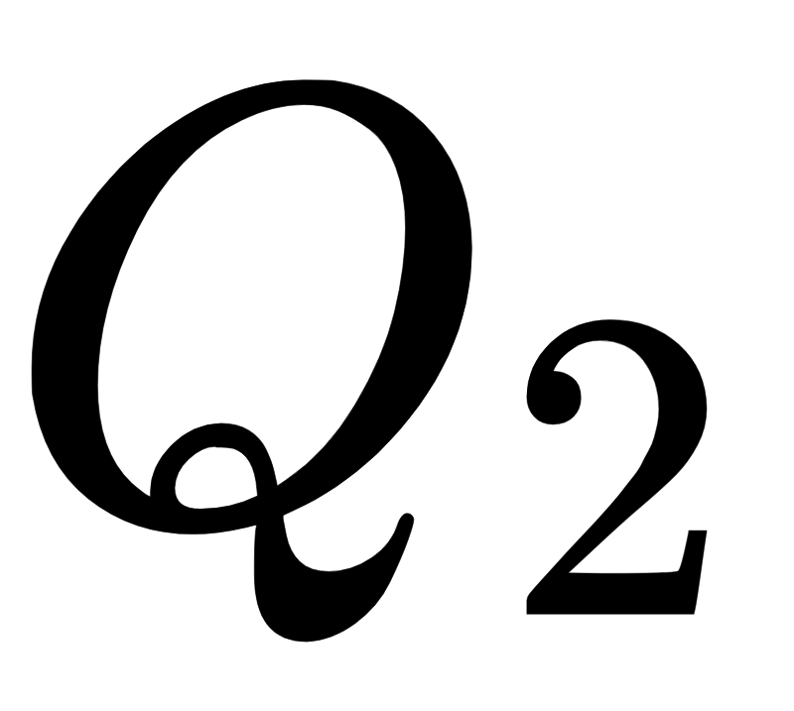

Conventional Quarkonium
A number of models for the formation a decay of exotics have been proposed.
Hadronic Molecules
Diquarkonium
Hybrid Mesons
Hadroquarkonium

Slide 22
Chapter 3:
The Dynamical Diquark Picture

Slide 23
Heavy Hadron

Slide 24
Heavy Hadron

Slide 25

Strong Decay
Heavy Hadron
Weak Decay

Slide 27
Anti-Diquark
At this moment, the diquarks have large relative momenta.
Diquark

Slide 29
As the diquarks separate, their large kinetic energies are turned into potential energies in the form of a gluefield.

Slide 30
Near the decay of the exotic, the system becomes nonrelativistic.

Slide 31

It is at this moment that we take a “snapshot” of the system using the Schroedinger equation to calculate the mass spectra of diquarkonium exotics

Slide 32
Chapter 4:
Results of the Dynamical Diquark Model (DDM)

Slide 33
Exotics in the DDM interact through QCD Born-Oppenheimer Potentials.
QCD Born-Oppenheimer Potential

Slide 34
At short distances, these potentials can become degenerate.
This forces us to solve coupled Schroedinger equations due to the quantum-mechanical mixing of Born-Oppenheimer states.
QCD Born-Oppenheimer Potential

Slide 35
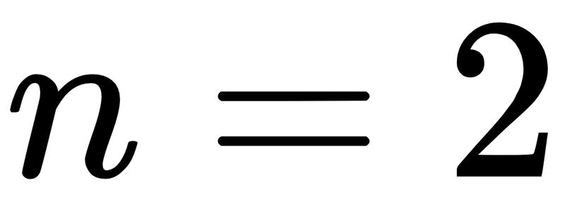
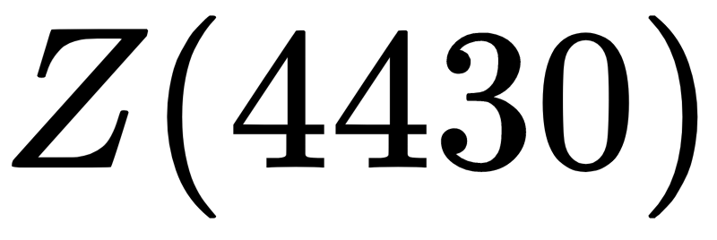
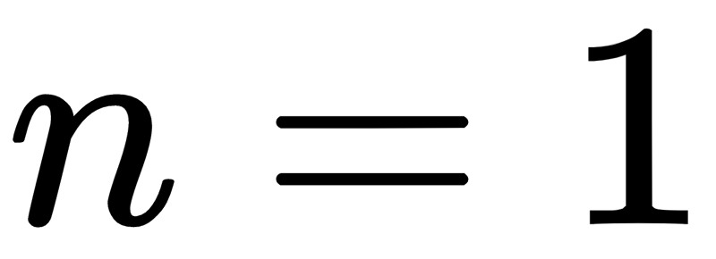
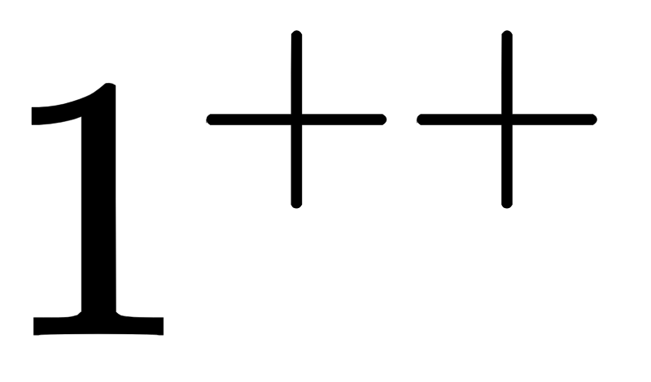
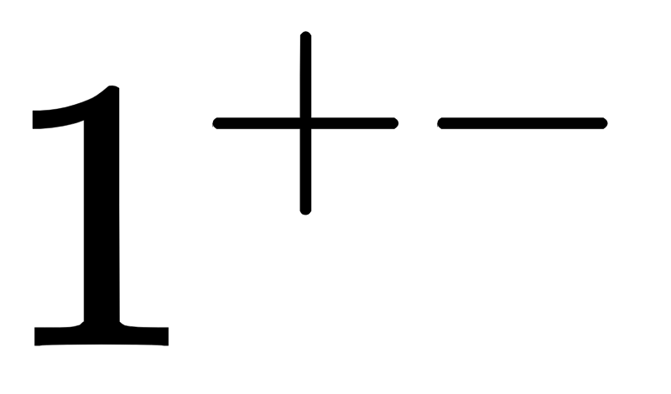

In our best fit, X(3872) is fit to the ground state and Z(4430) is fit to the first excited state.
Mass (MeV)

Slide 36
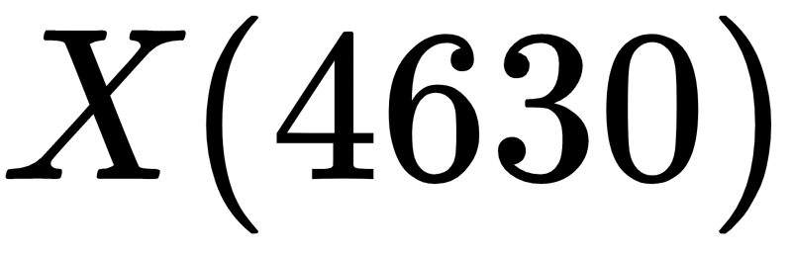

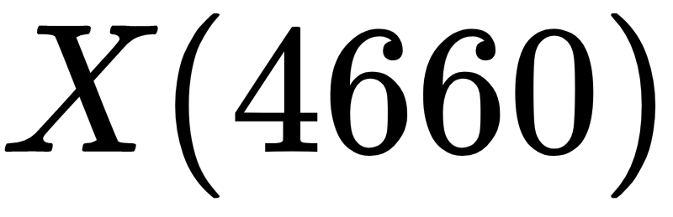
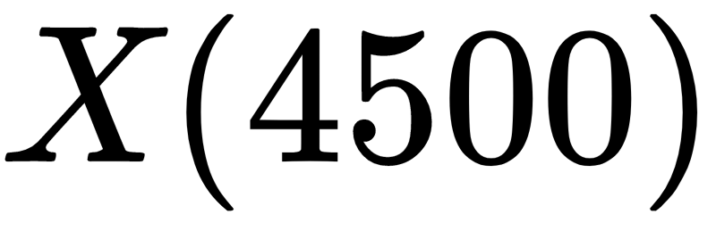

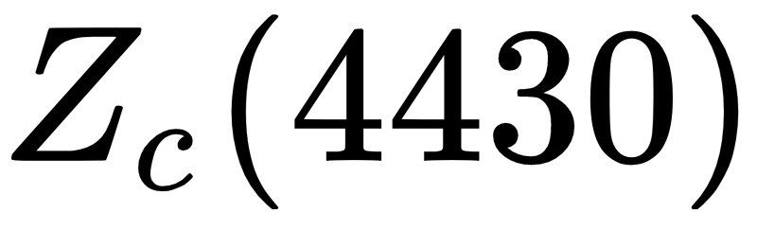
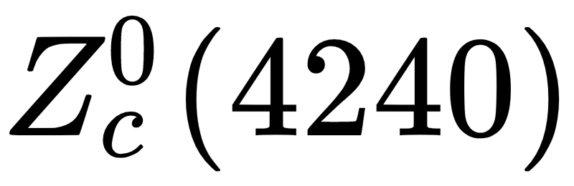
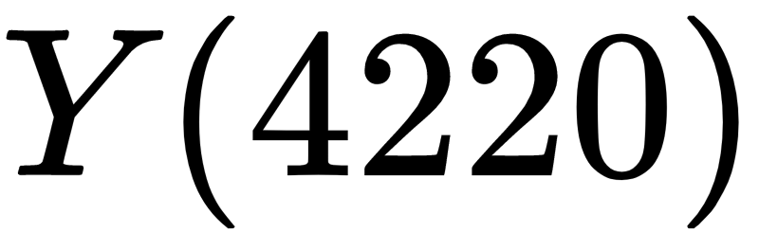
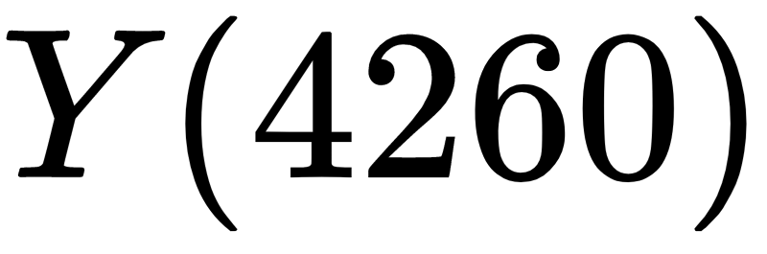
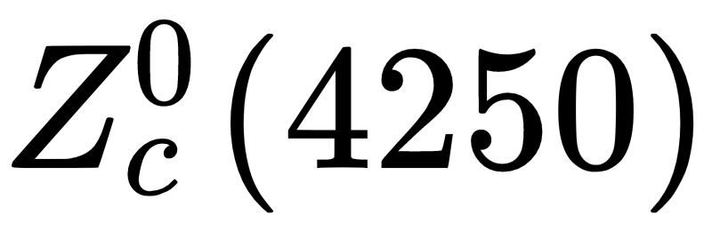
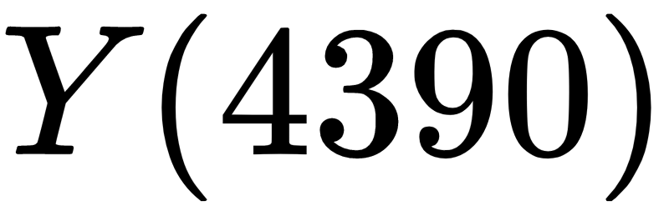
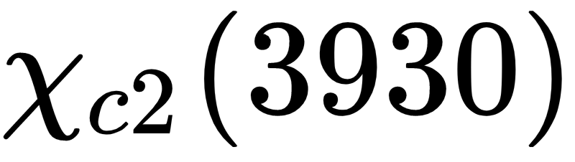
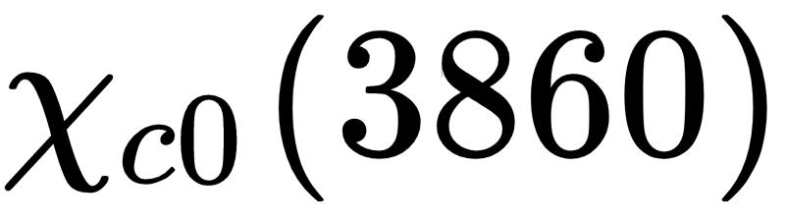
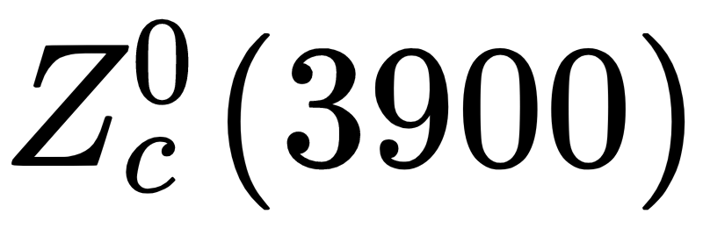
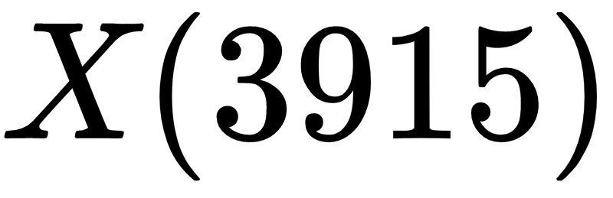
Estimating the magnitude of fine structure splittings, we obtain a band structure that matches well with experiment.
4750-4900 MeV
4570-4720 MeV
?
4220-4390 MeV
3900-4050 MeV

Slide 37
Estimating the magnitude of fine structure splittings, we obtain a band structure that matches well with experiment.
4750-4900 MeV
4570-4720 MeV
The parity eigenvalues have the characteristic “+-+-” pattern.
?
4220-4390 MeV
3900-4050 MeV

Slide 38
Estimating the magnitude of fine structure splittings, we obtain a band structure that matches well with experiment.
4750-4900 MeV
4570-4720 MeV
The parity eigenvalues have the characteristic “+-+-” pattern.
?
The band structure exhibits gaps for which no exotics are observed.
4220-4390 MeV
3900-4050 MeV

Slide 39
Estimating the magnitude of fine structure splittings, we obtain a band structure that matches well with experiment.
4750-4900 MeV
4570-4720 MeV
The parity eigenvalues have the characteristic “+-+-” pattern.
?
The band structure exhibits gaps for which no exotics are observed.
4220-4390 MeV
Candidates outside of the DDM band structure have controversial existence.
3900-4050 MeV

Slide 40
Further analysis will require actual calculations of the fine-structure contributions to the mass spectrum to determine the real band structure of the DDM.

Slide 41
Thank You:

Slide 42
Thank You:
Richard Lebed, Principal Investigator

Slide 43
Thank You:
Richard Lebed, Principal Investigator
Jesse Giron, Graduate Student

Slide 44
Thank You:
Richard Lebed, Principal Investigator
Jesse Giron, Graduate Student
Arizona Space Grant Consortium

